Slide 1

SIT1304
CLOUD COMPUTING
BY
Ms. B. KEERTHI SAMHITHA & Ms. SUJA. C. M
Assistant Professor
Department of CSE

Slide 2
UNIT 3
CLOUD DEPLOYMENT MODELS

Slide 3
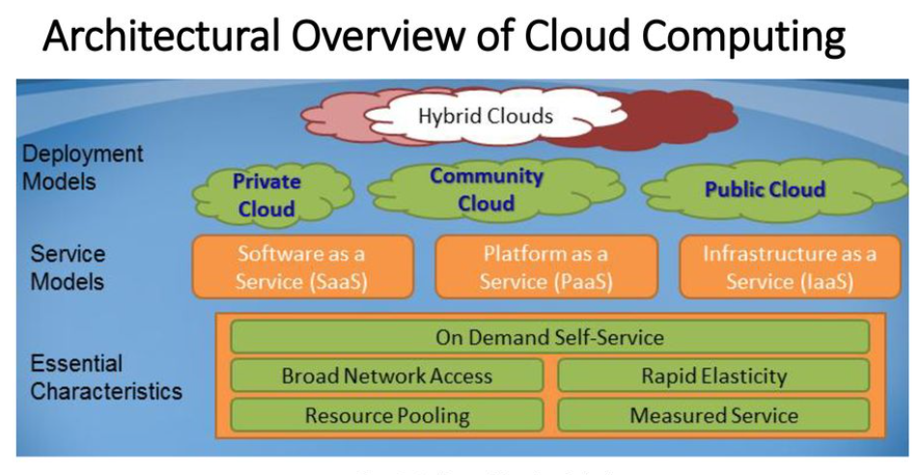
OVERVIEW OF CLOUD COMPUTING

Slide 4
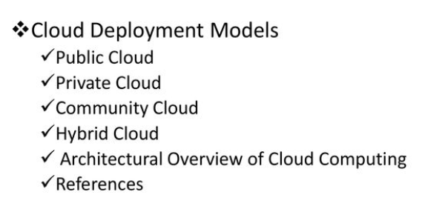
CLOUD DEPLOYMENT MODELS

Slide 5
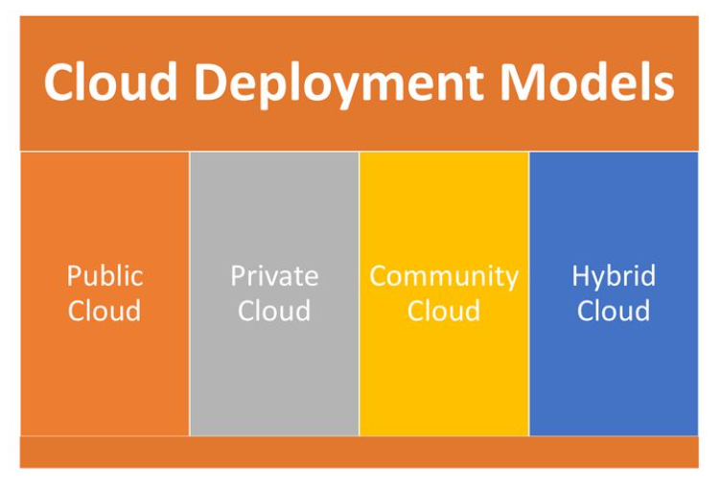
CLOUD DEPLOYMENT MODELS

Slide 6
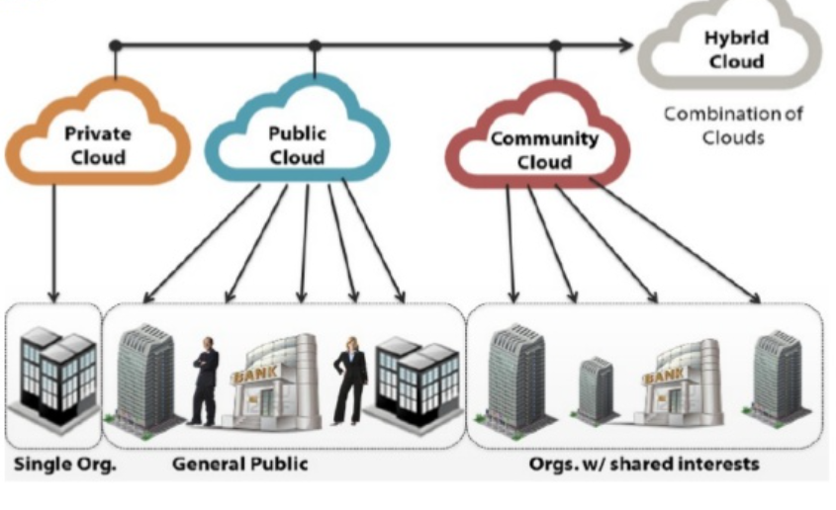

Slide 7
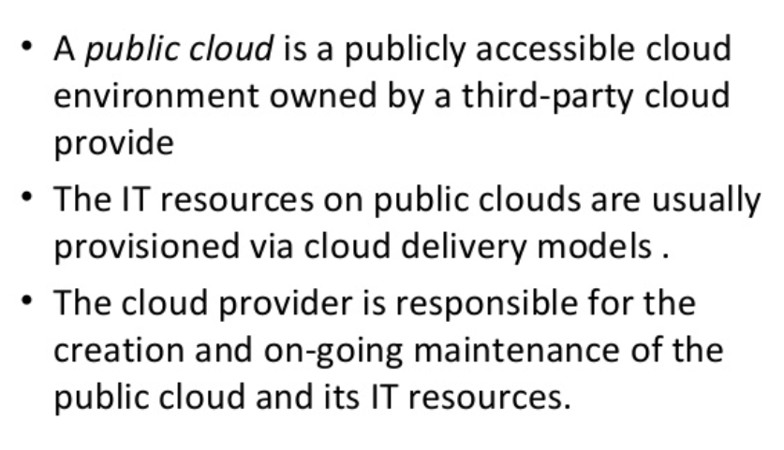
PUBLIC CLOUD

Slide 8
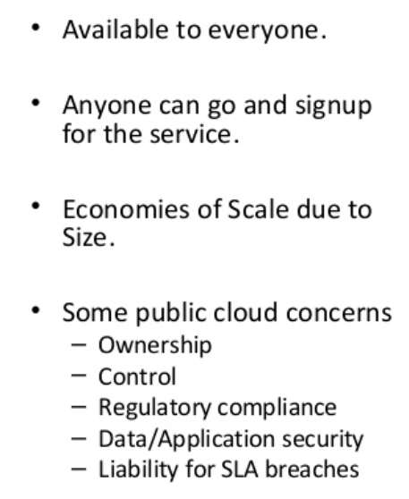
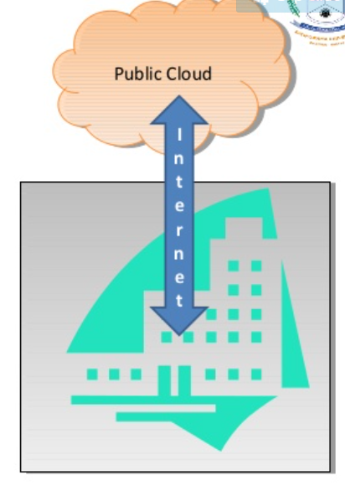
PUBLIC CLOUD

Slide 9
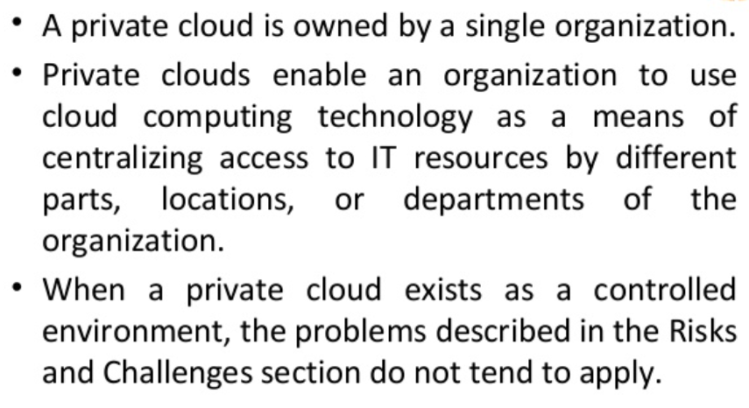
PRIVATE CLOUD

Slide 10
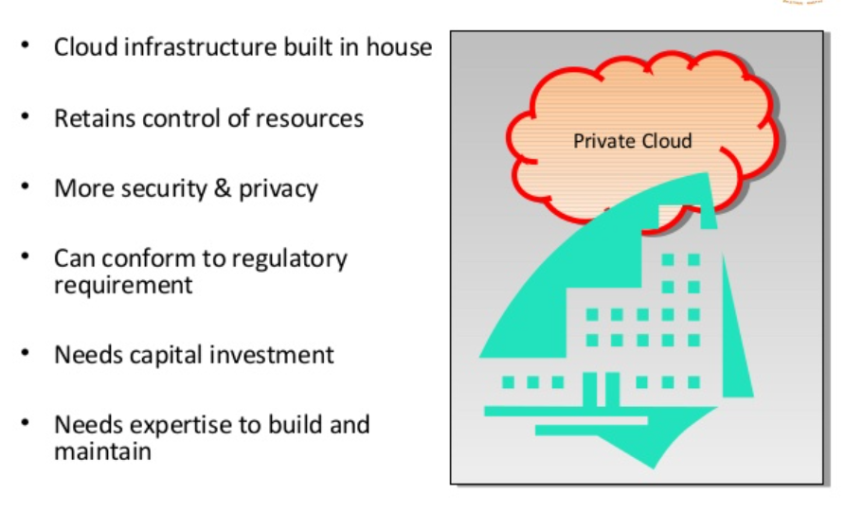
PRIVATE CLOUD

Slide 11
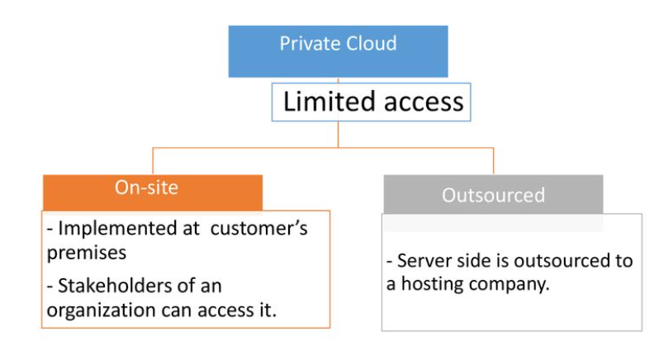
PRIVATE CLOUD

Slide 12
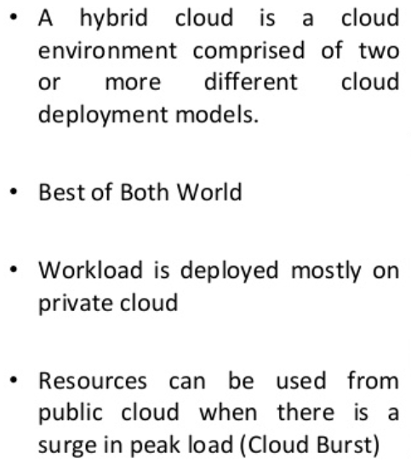
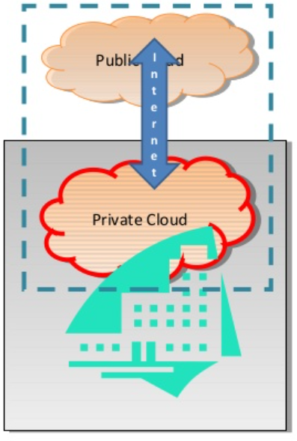
HYBRID CLOUD

Slide 13
DEPLOYMENT OF APPLICATIONS ON CLOUD
Steps to follow
Step 1: Prepare to Deploy
Step 2: Know Your Credentials and Target
Step 3: (Optional) Configure Domains
Step 4: Determine Deployment Options
Step 5: Push the App

Slide 14
Step 1: PREPARE TO DEPLOY
Before you deploy your app to Cloud Foundry, make sure that:
Your app is cloud-ready. Cloud Foundry behaviors related to file storage, HTTP sessions, and port usage may require modifications to your app.
All required app resources are uploaded. For example, you may need to include a database driver
Extraneous files and artifacts are excluded from upload. You should explicitly exclude extraneous files that reside within your app directory structure, particularly if your app is large.

Slide 15
STEP 1: PREPARE TO DEPLOY
An instance of every service that your app needs has been created.
Your Cloud Foundry instance supports the type of app you are going to deploy, or you have the URL of an externally available buildpack that can stage the app.

Slide 16
STEP 2: KNOW YOUR CREDENTIALS AND TARGET
Before you can push your app to Cloud Foundry you need to know:
The API endpoint for your Cloud Foundry instance. Your username and password for your Cloud Foundry instance.
The organization and space where you want to deploy your app. A Cloud Foundry workspace is organized into organizations, and within them, spaces. As a Cloud Foundry user, you have access to one or more organizations and spaces.

Slide 17
STEP 3: (OPTIONAL) CONFIGURE DOMAINS
Cloud Foundry directs requests to an app using a route, which is a URL made up of a host and a domain.
The name of an app is the default host for that app, unless you specify the host name with the -n flag.
Every app is deployed to an app space that belongs to a domain.
Every Cloud Foundry instance has a default domain defined.
You can specify a non-default, or custom, domain when deploying, provided that the domain is registered and is mapped to the organization which contains the target app space.

Slide 18
STEP 4: DETERMINE DEPLOYMENT OPTIONS
Before you deploy, you need to decide on the following:
Name: You can use any series of alpha-numeric characters as the name of your app.
Instances: Generally speaking, the more instances you run, the less downtime your app will experience. If your app is still in development, running a single instance can simplify troubleshooting. For any production app, we recommend a minimum of two instances.
Memory Limit: The maximum amount of memory that each instance of your app can consume. If an instance exceeds this limit, Cloud Foundry restarts the instance.

Slide 19
STEP 4: DETERMINE DEPLOYMENT OPTIONS
Start Command: This is the command that Cloud Foundry uses to start each instance of your app. This start command varies by app framework.
Subdomain (host) and Domain: The route, which is the combination of subdomain and domain, must be globally unique. This is true whether you specify a portion of the route or allow Cloud Foundry to use defaults.
Services: Apps can bind to services such as databases, messaging, and key-value stores. Apps are deployed into app spaces. An app can only bind to a service that has an existing instance in the target app space.

Slide 20
STEP 5: PUSH THE APP
Run the following command to deploy an app without a manifest:
cf push APP-NAME

Slide 21
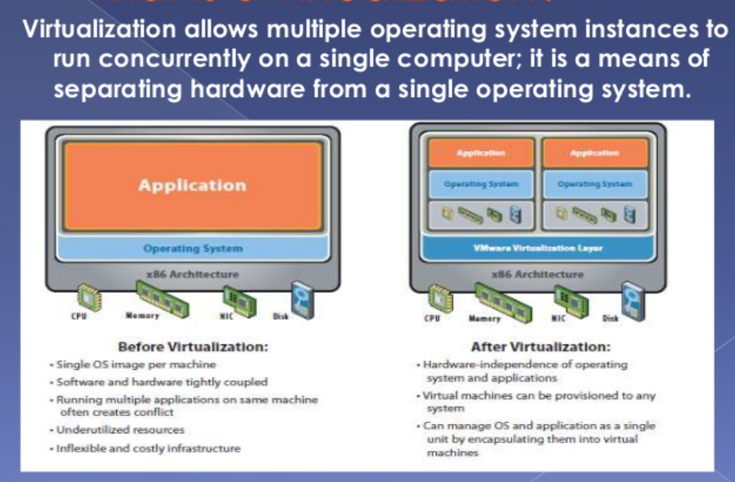
HYPERVISOR WHAT IS VIRTUALIZATION?

Slide 22
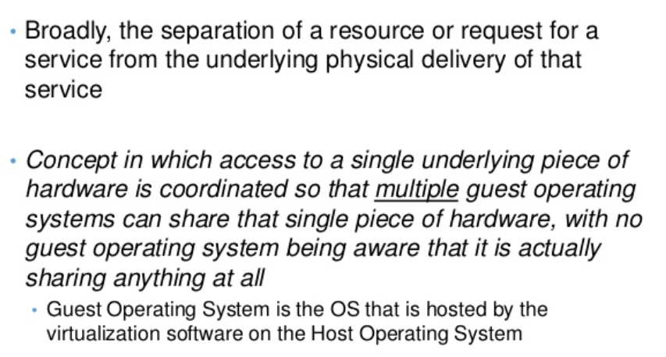
WHAT IS VIRTUALIZATION?

Slide 23
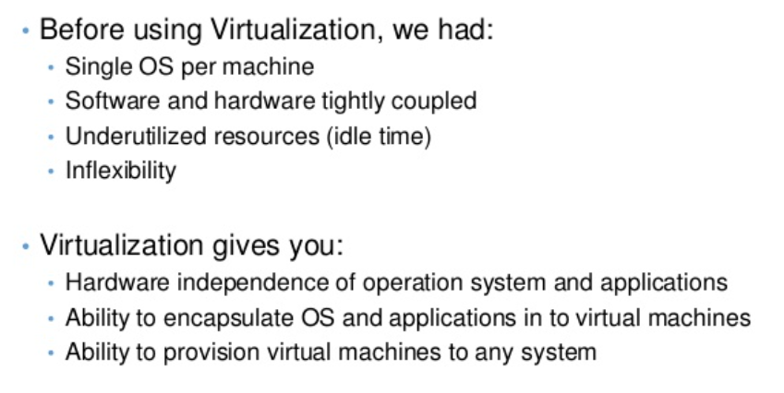
WHAT IS VIRTUALIZATION?

Slide 24
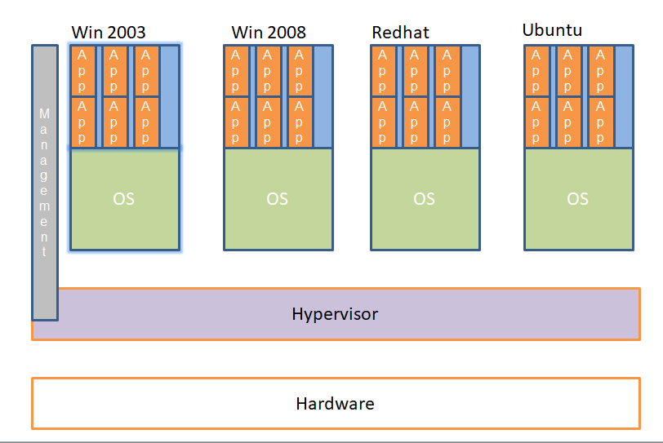
TYPICAL SERVER VIRTUALIZATION DEPLOYMENT

Slide 25
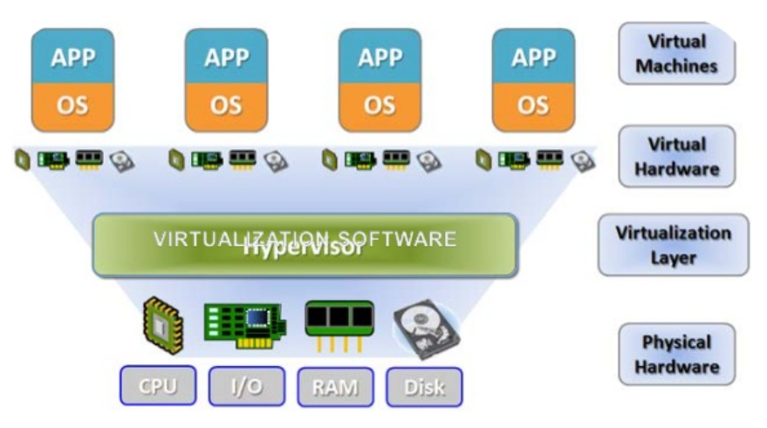

Slide 26
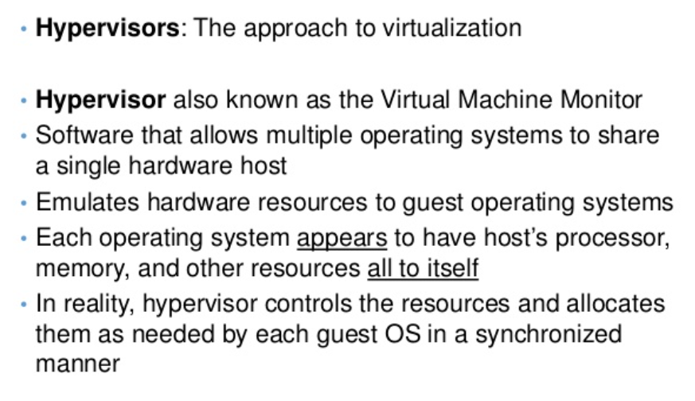
HYPERVISOR

Slide 27
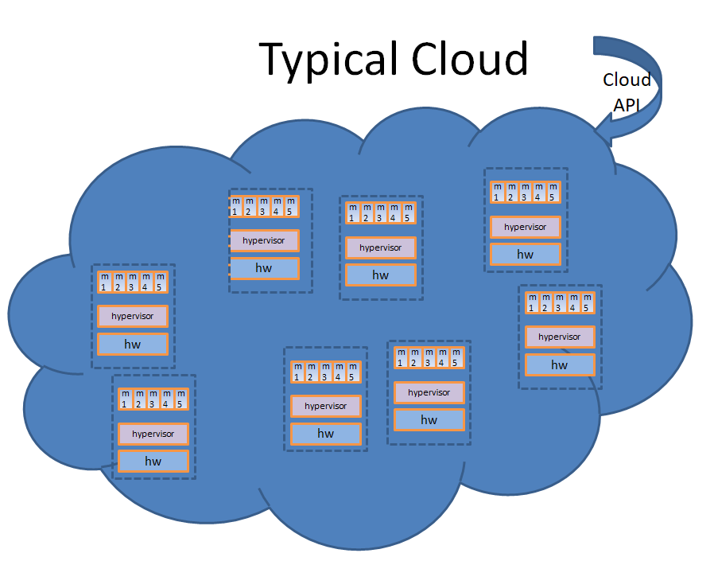

Slide 28
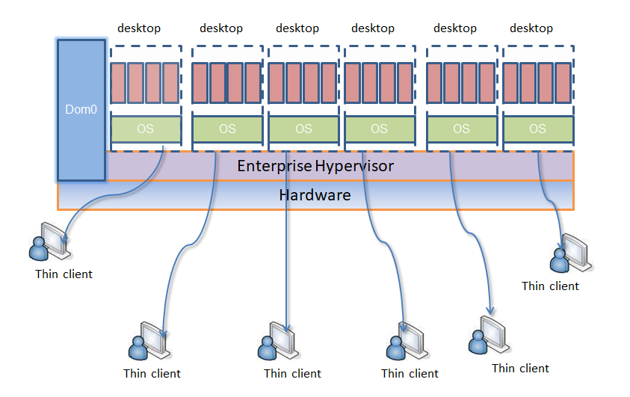
TYPICAL VDI DEPLOYMENT

Slide 29
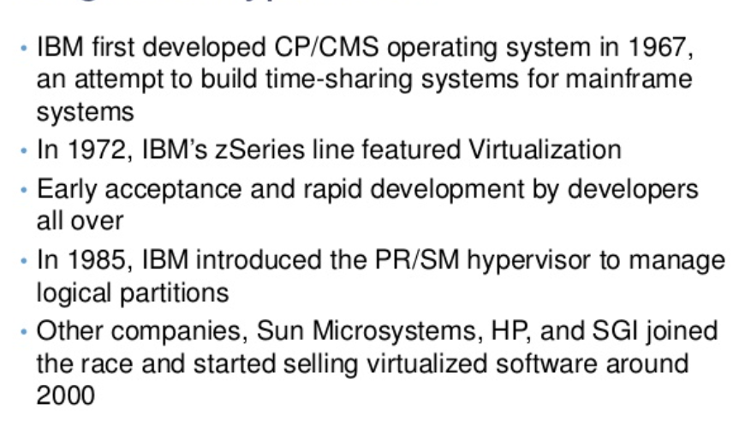
ORIGIN OF HYPERVISOR

Slide 30
SECURITY ISSUES IN HYPERVISOR
Hypervisor is the underlying component of all these architectures. It is a new layer which needs to be protected
Scale of deployments – Just the sheer scale of deployments make this a security nightmare.
Imagine 150 machines running a simultaneous scheduled AV scan on the same physical host. Chokes IO/Disk bandwidth.
Isolation - Machines of a company and its competitor could be running on the same physical machine. Insufficient isolation could lead to disaster
New API’s to access Virtualization/Cloud services.
Bugs in these could lead to compromise of entire infrastructure.

Slide 31
SECURITY ISSUES – WHY?
Hypervisors are written by humans. They have bugs – typically buffer overflows
Hypervisor are complex – Xen is about 300K source lines of code
Complete isolation is hard – Most systems don’t have IOMMU’s which make it possible to DMA to arbitrary physical memory
Compromised Domain0 on Xen pretty much means a hosed hypervisor. Domain0 runs commodity OS’s which could have bugs.

Slide 32
SECURITY ISSUES – WHY?
DMA is a big problem on non IOMMU based systems:
Xen can setup DMA
Dom0 can setup DMA
Driver domains can setup DMA
The range of physical addresses is not verified
IOMMU based systems can restrict the range of addresses but they are not present in commodity hardware
There are some techniques to even bypass IOMMU checks

Slide 33
SECURITY SOLUTIONS
Trusted hypervisor
Hyperguard – Phoenix Technologies – A hypervisor integrity scanner in SMM.
Deepwatch – Intel project – Virtualization rootkit scanner
Domain 0 Hardening – Various security solutions to white-list and harden Dom0

Slide 34
SECURITY OPPORTUNITIES
New breed of security products is now possible to protect guest OS’s from being hijacked
Hypervisor based security suites cannot be detected by malware running in the guest
Hypervisors allow introspection of very early boot sequences of the guest, thereby making possible an entire need breed of BIOS rootkit and kernel rootkit scanners

Slide 35
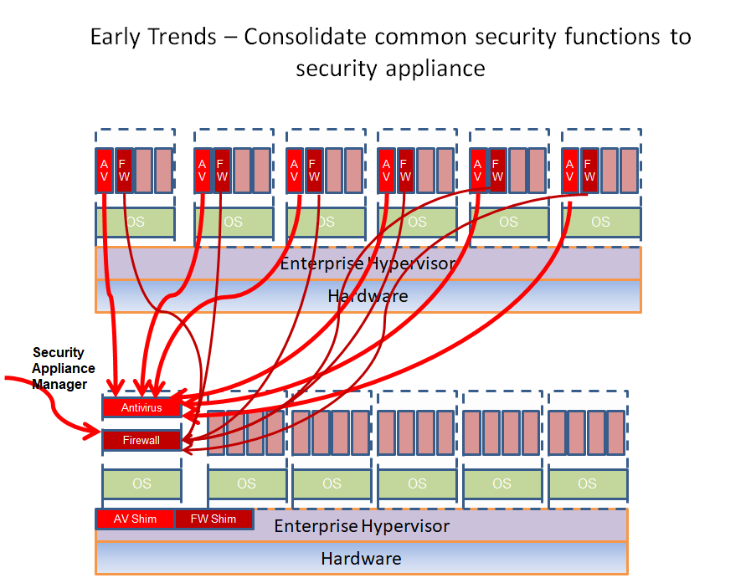

Slide 36
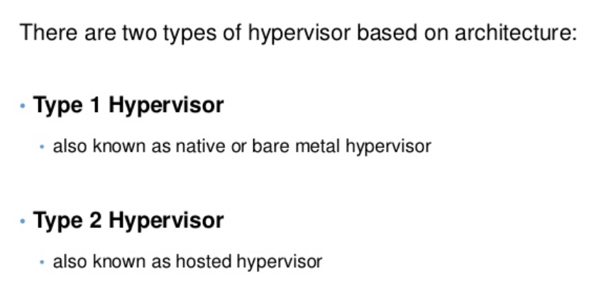
CLASSIFICATIONS OF HYPERVISOR

Slide 37
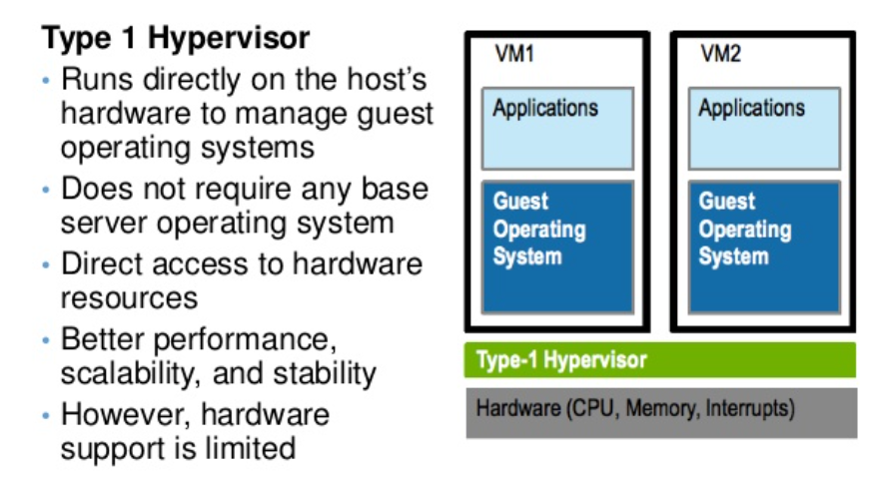
CLASSIFICATIONS OF HYPERVISOR

Slide 38
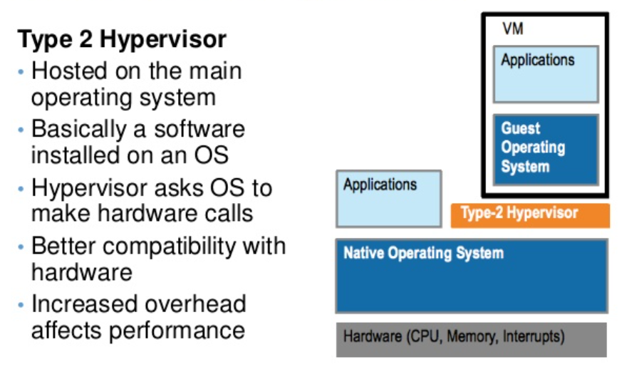
CLASSIFICATIONS OF HYPERVISOR

Slide 39
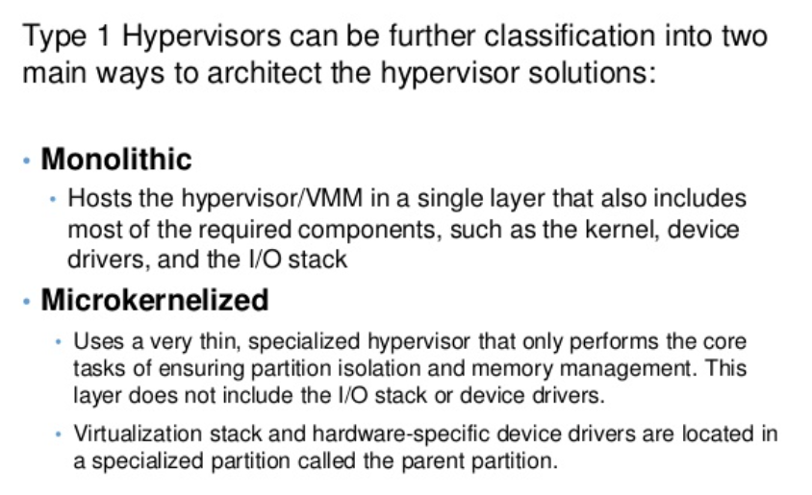
CLASSIFICATIONS OF HYPERVISOR

Slide 40
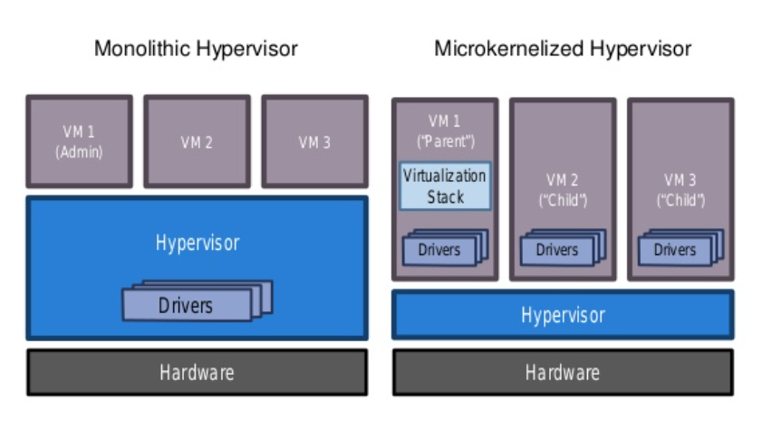

Slide 41
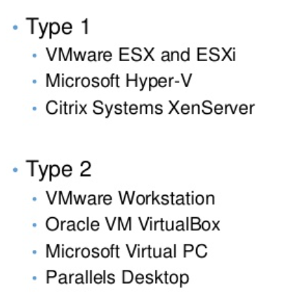
LEADING HYPERVISORS

Slide 42
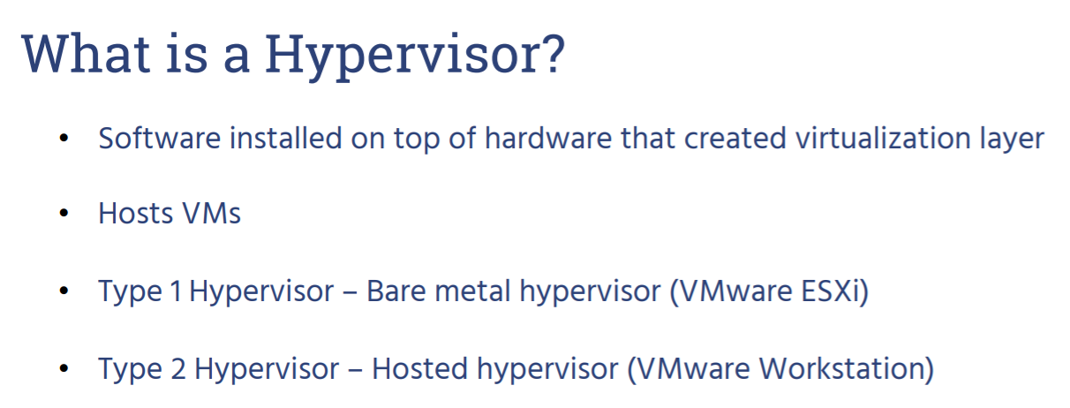
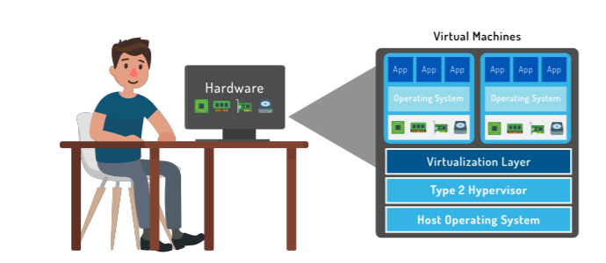

Slide 43
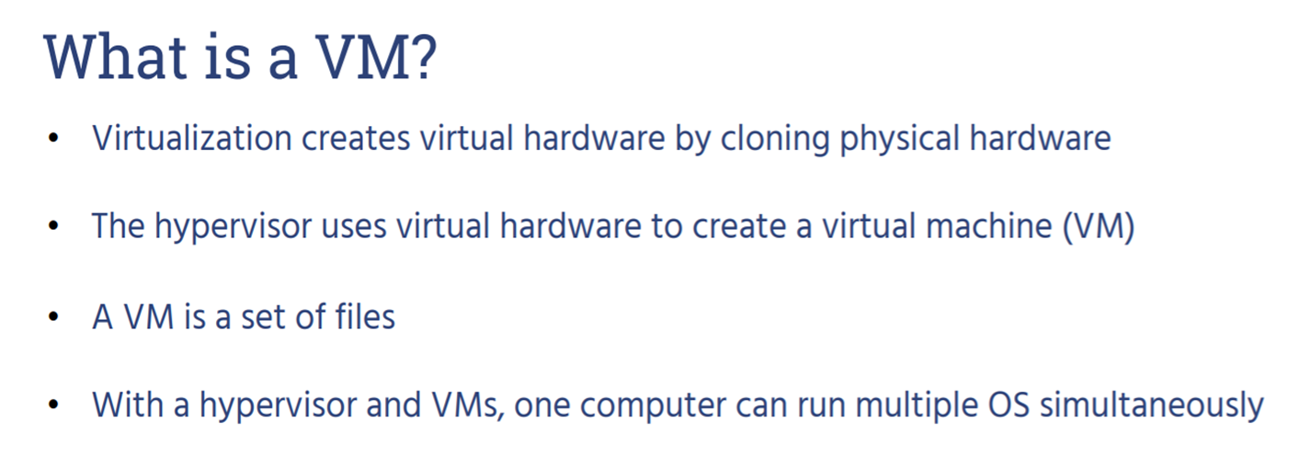
CASE STUDIES : VMware

Slide 44
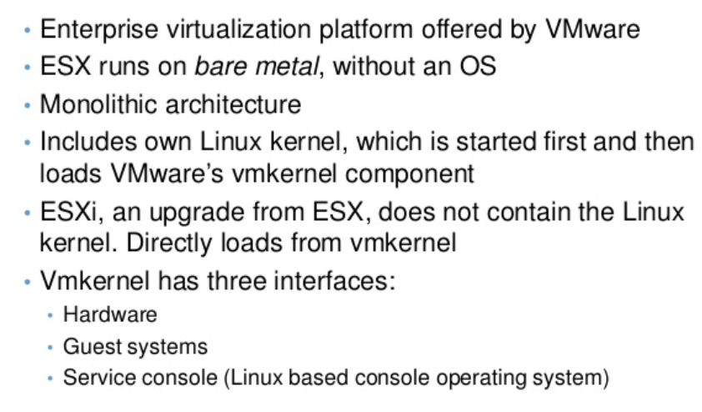
VMware ESX (Elastic Sky X) and ESX i (ESX Integrated)

Slide 45
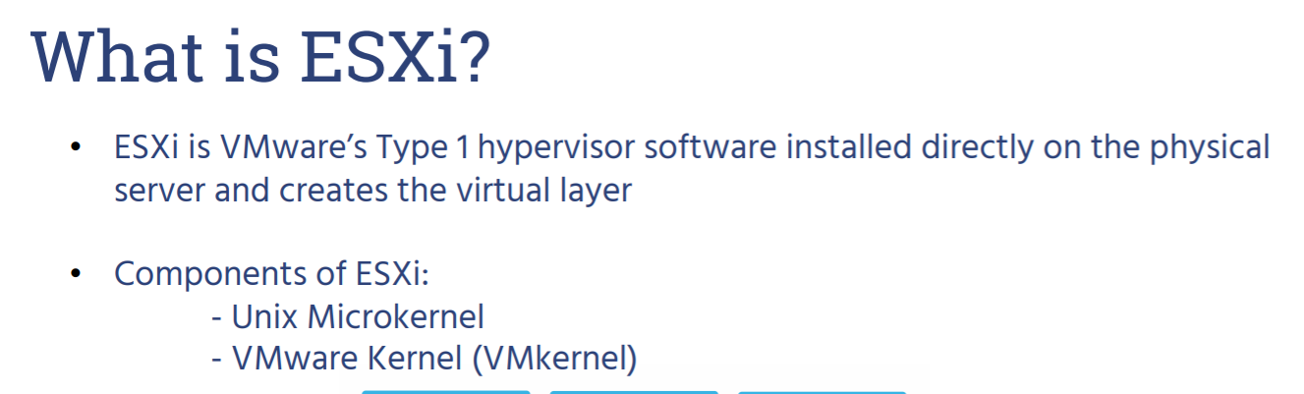
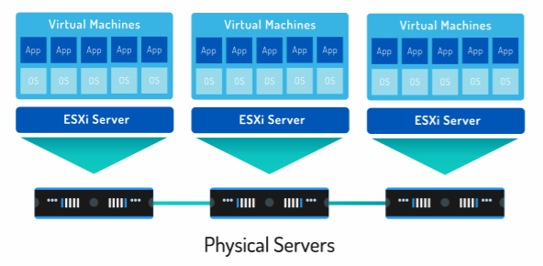

Slide 46
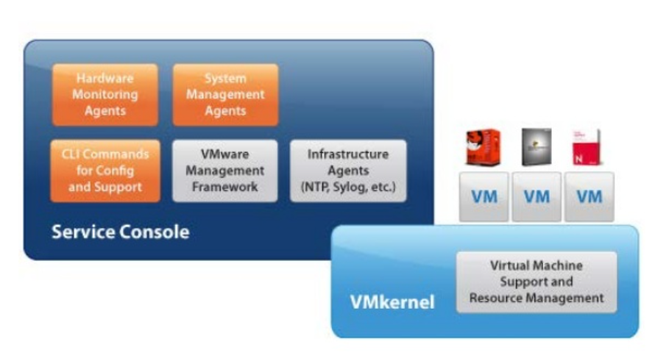
VMware ESX Architecture

Slide 47
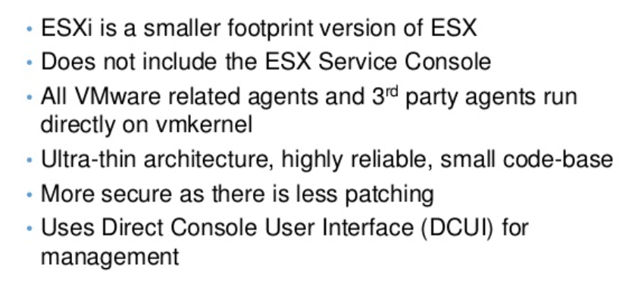
VMware ESXi

Slide 48
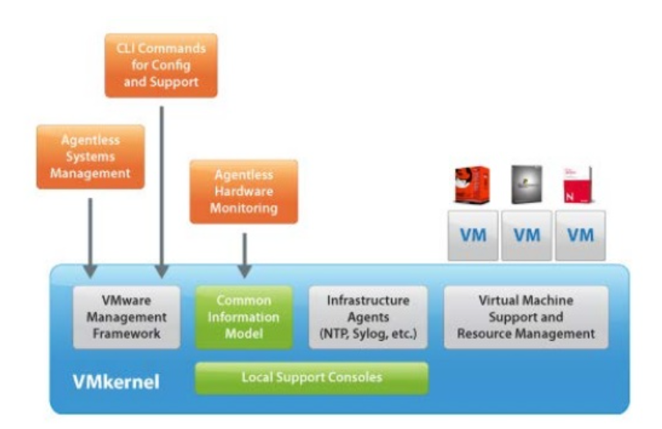
VMware ESXi Architecture

Slide 49
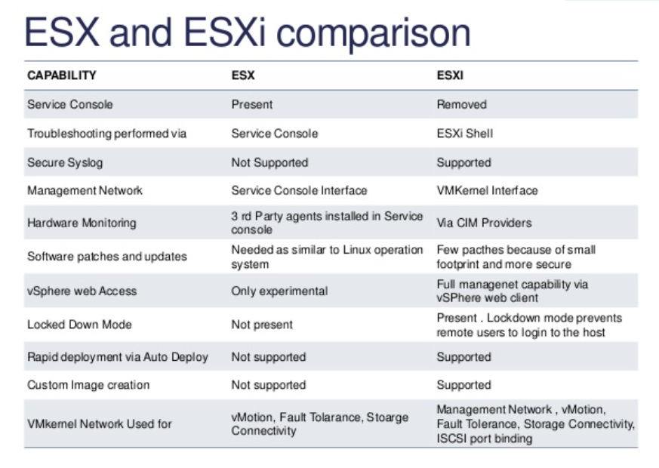

Slide 50
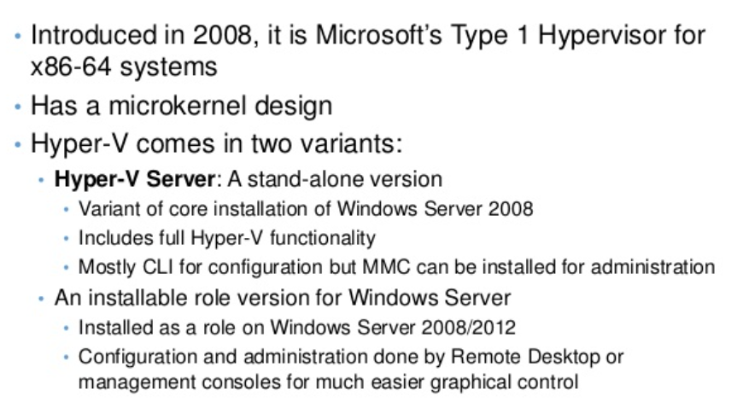
CASE STUDIES : HYPER V

Slide 51
WHAT IS HYPER V?
Hyper-V Manager is a free Windows Server tool.
It performs the most basic VM CRUD functions—create, read (or retrieve), update and delete virtual machines.
But it comes with significant limitations.
User can't move VMs between hosts using Hyper-V Manager, and you can only view one host at a time.

Slide 52
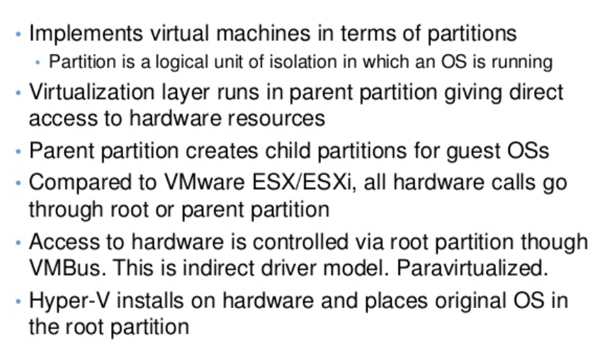
HYPER V ARCHITECTURE

Slide 53
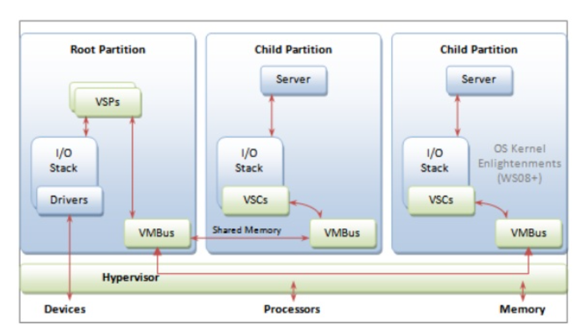
HYPER V ARCHITECTURE

Slide 54
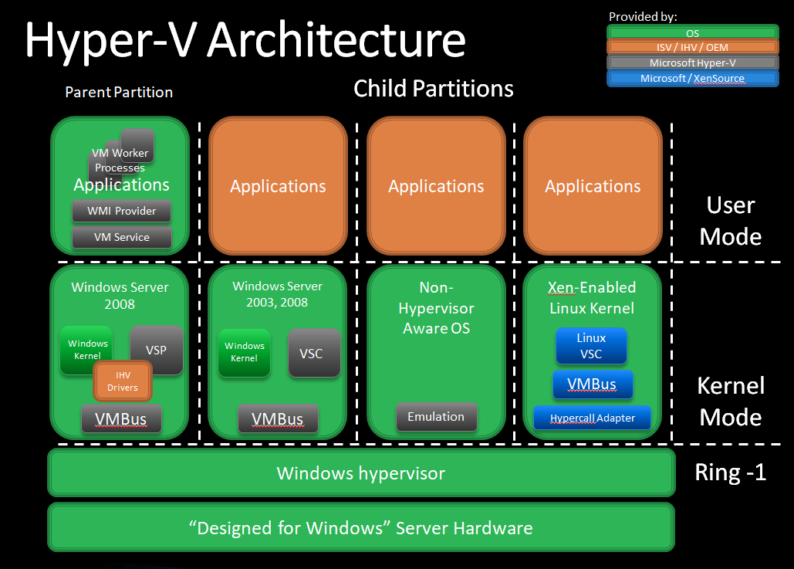

Slide 55
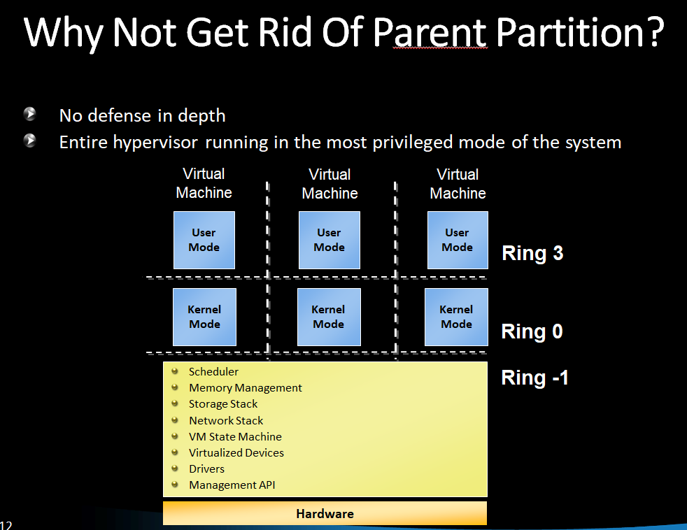

Slide 56
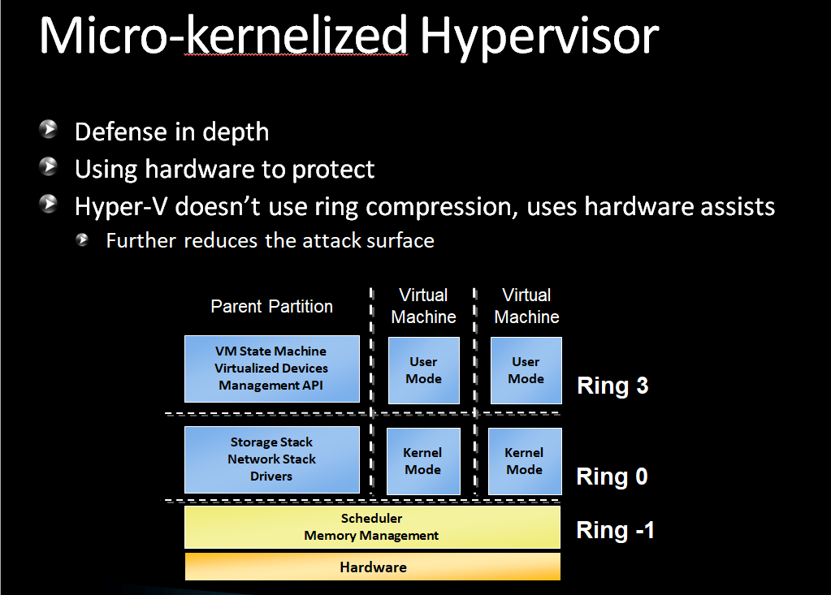

Slide 57
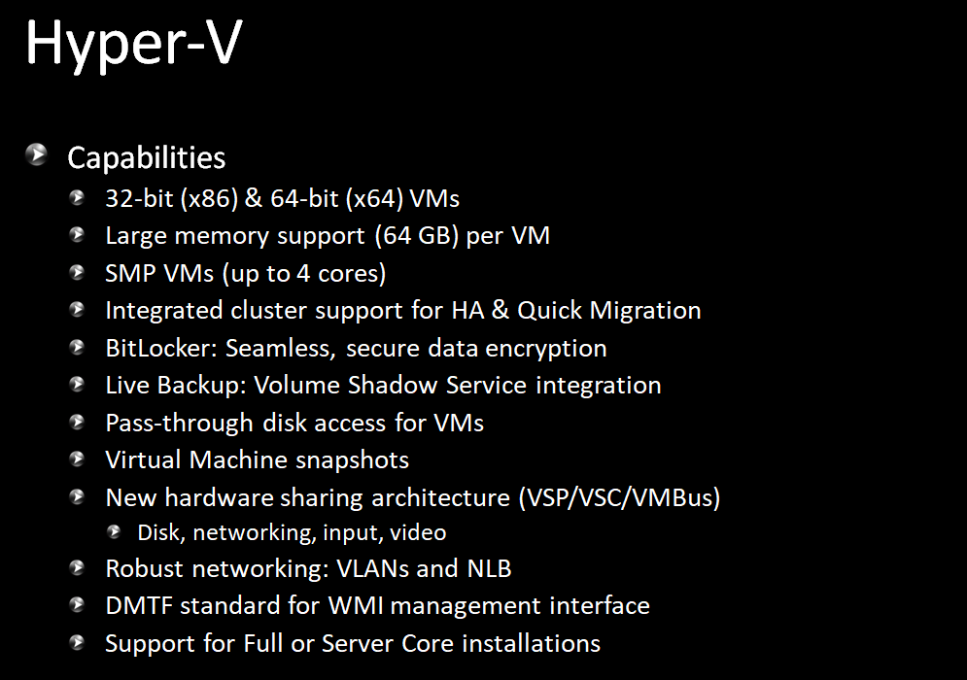

Slide 58
BENEFITS OF HYPER V
Simply Deployments
Increase Flexibility
Lower Costs
Do more with less
Scale Operations
Raise Reliability
Maximize Resources
Future Proof IT

Slide 59
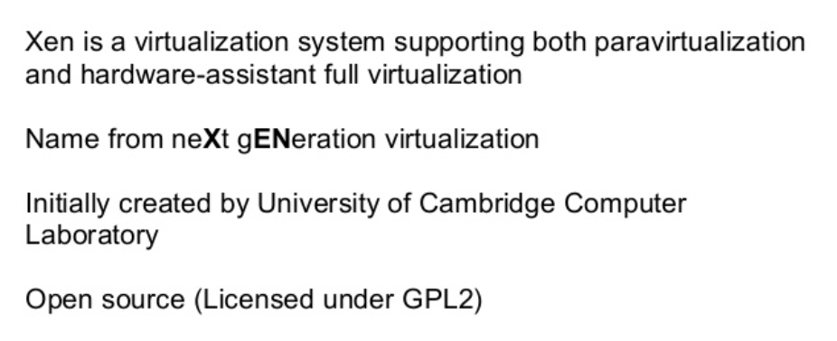
CASE STUDIES : XEN

Slide 60
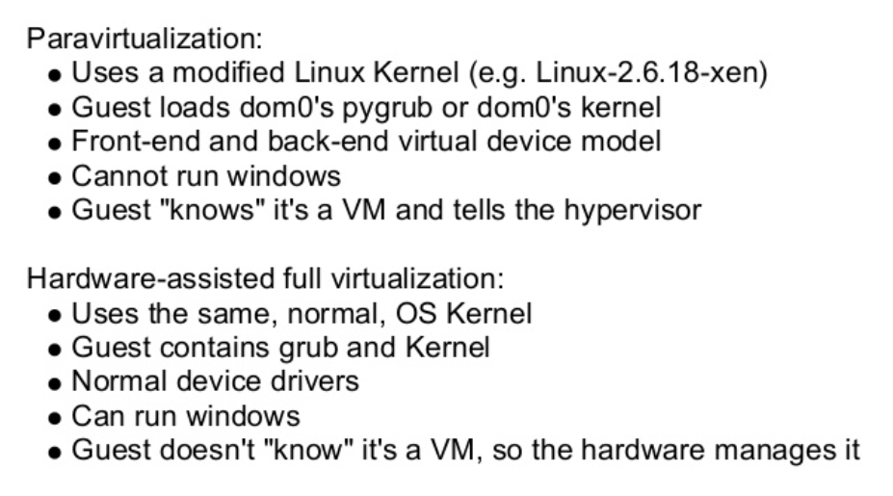
VIRTUALIZATION IN XEN

Slide 61
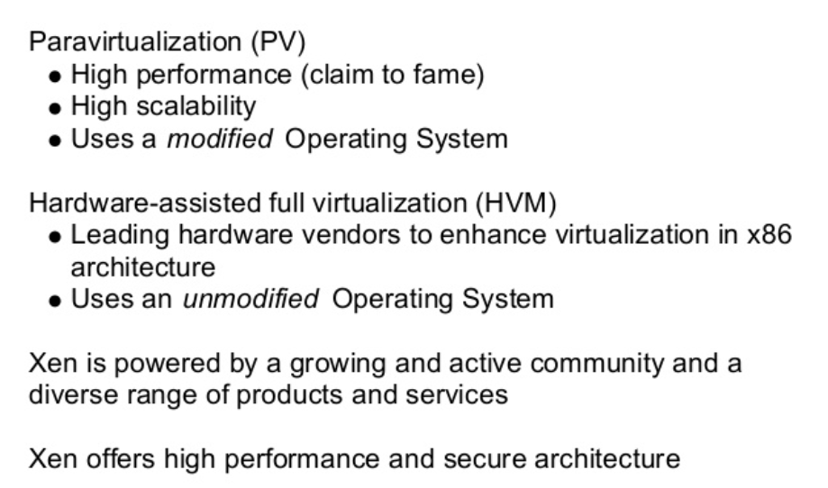
WHY TO USE XEN?

Slide 62
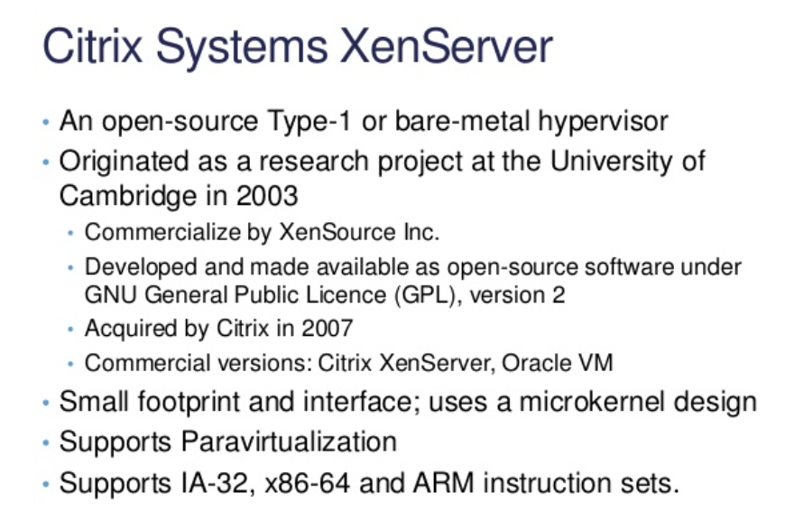
CASE STUDIES : XEN

Slide 63
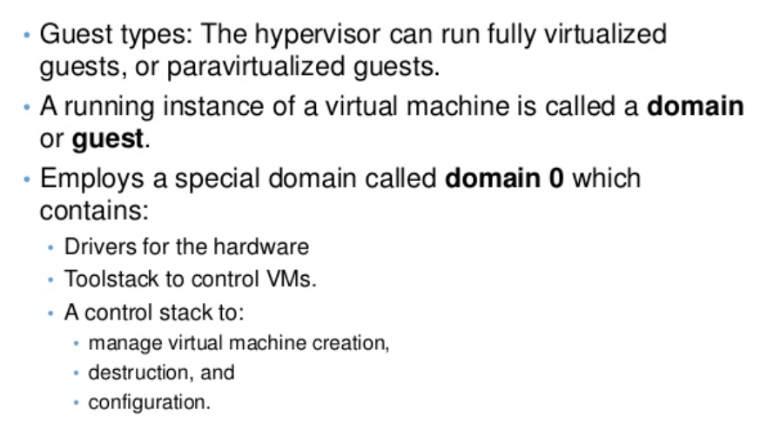
XEN ARCHITECTURE

Slide 64

XEN ARCHITECTURE

Slide 65

ARCHITECTURE OF XEN

Slide 66

ARCHITECTURE OF XEN

Slide 67

CASE STUDIES : KVM

Slide 68

KVM

Slide 69

CASE STUDIES : AMAZON EC2 (AMAZON Elastic Compute Cloud)

Slide 70
AMAZON EC2
Amazon Machine Images (AMIs) are the basic building blocks of Amazon EC2
An AMI is a template that contains a software configuration (operating system, application server and applications) that can run on Amazon’s computing environment

Slide 71
GETTING STARTED WITH AMAZON EC2
Step 1: Sign up for Amazon EC2
Step 2: Create a key pair
Step 3: Launch an Amazon EC2 instance
Step 4: Connect to the instance
Step 5: Customize the instance
Step 6: Terminate instance and delete the volume created

Slide 72


CASE STUDIES : VIRTUAL BOX

Slide 73


Slide 74

KEY FEATURES OF VIRTUAL BOX

Slide 75

KEY FEATURES OF VIRTUAL BOX

Slide 76

CASE STUDIES : EUCALYPTUS

Slide 77

WHY EUCALYPTUS?

Slide 78

WHY EUCALYPTUS?

Slide 79

WHY EUCALYPTUS?

Slide 80

SECURITY BASED EUCALYPTUS

Slide 81


COMPONENTS OF EUCALYPTUS

Slide 82

ARCHITECTURE OF EUCALYPTUS

Slide 83

COMPONENTS OF EUCALYPTUS

Slide 84

COMPONENTS OF EUCALYPTUS

Slide 85


Slide 86

COMPONENTS OF EUCALYPTUS

Slide 87



Slide 88

BENEFITS OF EUCALYPTUS

Slide 89

ADVANTAGES OF HYPERVISOR

Slide 90

ADVANTAGES OF HYPERVISOR

Slide 91

DISADVANTAGES

